Slide 1
Project on Micro-Credit Defaulter Model
Salman Pradhan
Submitted by

Slide 2

Importing Various Libraries
1.Numpy
2.Pandas
3.Matplotlib
4.Seaborn
5.Scikit_learn
6.imblearn

Slide 3
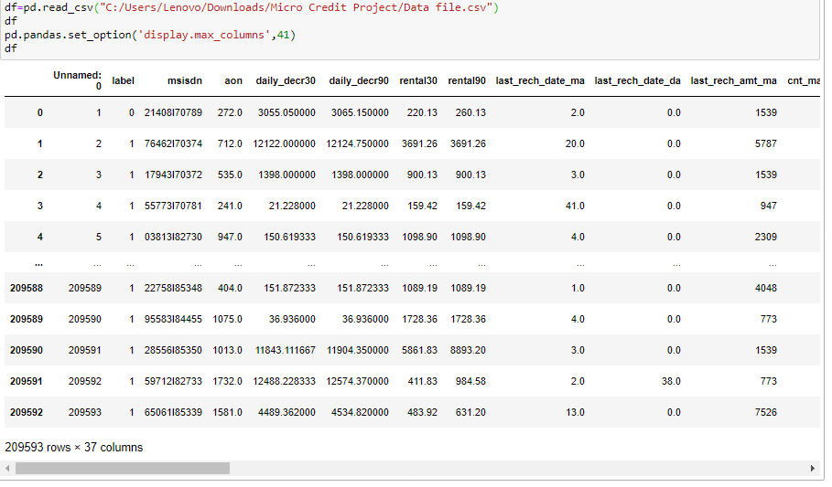
About Dataset
1.Loading dataset
2.Checking dimension
3.Checking columns
4.Checking column’s type
5.Statistical analysis
6.Checking Null values

Slide 4
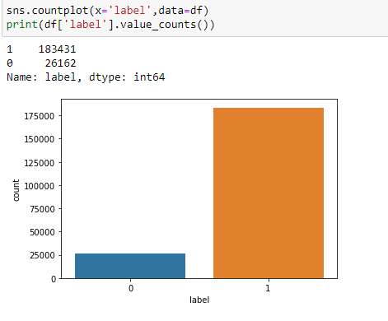
From dataset we get information as:
Dataset has no null values.
Dataset has target variable lable with 2 unique values so it is binary classification problem statement.
Pcircle feature has only 1 value so wemay drop that column

Slide 5
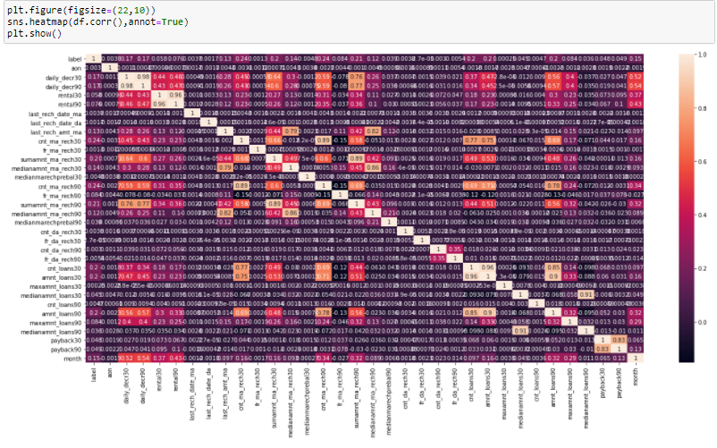
Checking Corelation
We have to check corelation of features against target column
Features having corelation approxmately 0 with target variable may drop

Slide 6
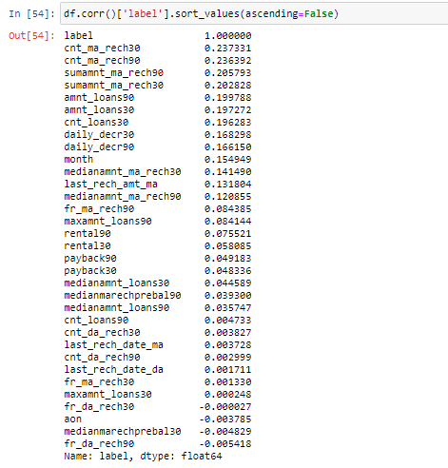

Slide 7
Features Selection
Columns like Unnamed 0,msisdn,pdate,pcircle has less impact on output feature so we may drop it.

Slide 8
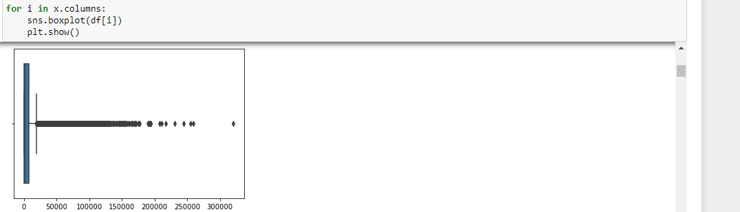
Checking Outliers
We have to visualize boxplot to check outliers present in dataset.
We use for loop to see boxplot of all numerical features.

Slide 9
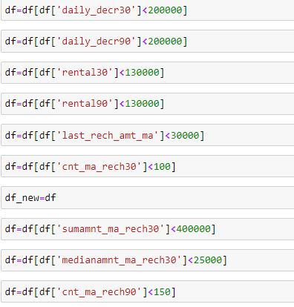
Removing Outliers
Looking at feature’s description and boxplot We remove outliers.
Outliers present in the dataset is 1.11% of the dataset.

Slide 10
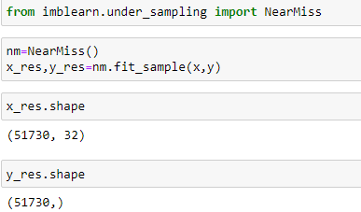
Under_sampling
As we clearly see that the dataset is imbalanced(88% is1 and 12 % is 0 in target feature),We have to use undersampling or oversampling technique to make the dataset balanced.
Using under_sampling technique We get dataset is like below

Slide 11
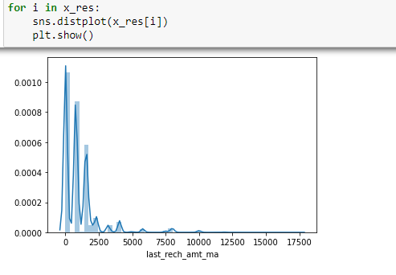
We have to see distribution of features in new updated dataset.

Slide 12
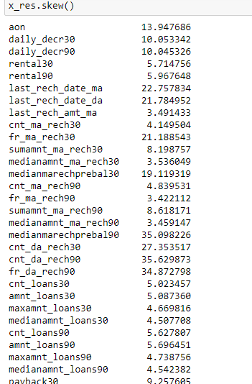
Checking Skewness
Some columns have skewness as we see clearly below image.

Slide 13

We have to remove skewness by power_transform method.

Slide 14
Model building
Now we have to divide dataset in 80% training and 20% for testing purpose.
We have to use different algorithm and check it’s accuracy.
Then we have see roc_auc_score and curve to get better model.

Slide 15
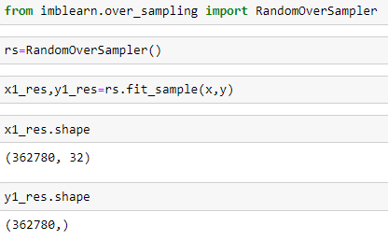
Over_sampling
We have to import_ over sampling and repeat tasks what we did in under_sampling(skewness removal,different algorithm used) till model building.

Slide 16
Algorithm used for model building:
1.LogisticRegression
2.DecisionTreeClassifier
3.XGBClassifier
4.GaussianNB
5.RandomForestClassifier
6.AdaBoostClassifier
7.GradientBoostingClassifier

Slide 17
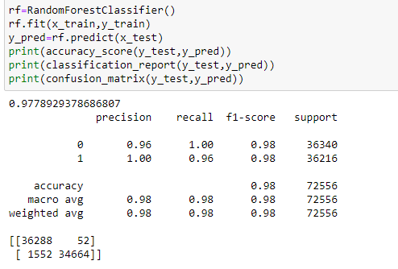
After using above algorithms we found that RandomForestClassifier is the best model for the dataset.

Slide 18
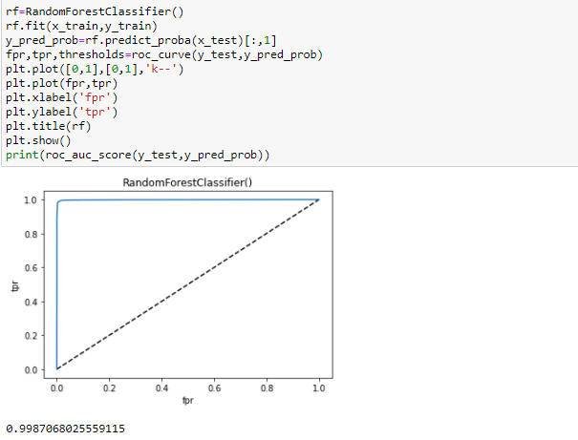
Checking roc_auc_score
After checking roc_auc_score of all models,RandomForestClassifier is the best model.

Slide 19
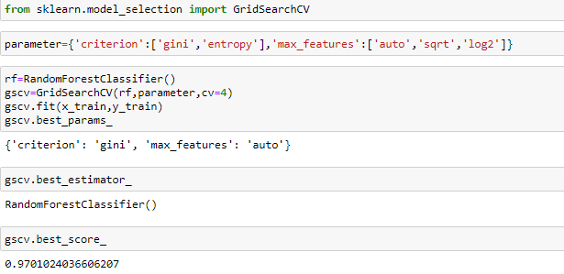
HyperParameter Tuning
Now we have to hypertune parameters of this model to improve accuracy score by using gridsearchcv.

Slide 20
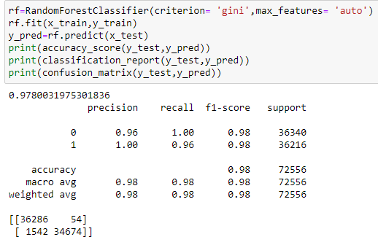
After tuning of parameter accuracy score of model
improves from 97.78% to 97.80%.

Slide 21
Conclusion
I remove approximately 1.1% outlier from the dataset which is pretty good not much of information is lost.
I have used 80% of dataset for traing and remaining 20% of data for testing purposes.
As its output value is 2,it is binary classification problem statement.I have used various various classification algorithm to predict output such as LogisticRegression,GaussianNB,XGBClassifier,DecisionTreeClas sifier,and ensemble technique like RandomForestClassifier,AdaBoostClassifier,GradientBoosting Classifier.After using all algorithm I found that RandomForestClassifier is best model for this dataset as it’s recall,precision,f1_score and accuracy_score is above 96% which is high compared to other algorithms.

